Slide 1


BANK OF AMERICA
AURIX
Audit Reasoning & Intelligent eXplainer (Multi-Agent Audit Engine)
By: Soumili Mukherjee
Pritam Sarkar
Sadhna Mall
Page 01

Slide 2

BANK OF AMERICA
Contact
Home
PROBLEM
STATEMENT
Enterprise audit processes involve matching invoices, ledgers, and internal policies.
Manual audit is slow and error-prone due to:
Vendor name variations
Ambiguous descriptions
Policy complexity
Missing documentation
There is a need for a reasoning-based automated auditor that can explain decisions.
Page 02

Slide 3
BANK OF AMERICA
OBJECTIVE
Automate reconciliation between invoices and ledger entries.
Perform policy compliance evaluation.
Provide transparent and explainable reasoning.
01.
02.
03.
Use a multi-agent workflow to break down audit tasks logically.
Deliver structured outputs for downstream systems.
04.
05.
Page 03

Slide 4



BANK OF AMERICA
WHAT AURIX PROVIDES
Intelligent Financial Reconciliation
Automated Policy Compliance & Risk Detection
Explainable Multi-Agent Reasoning Pipeline
Page 04

Slide 5
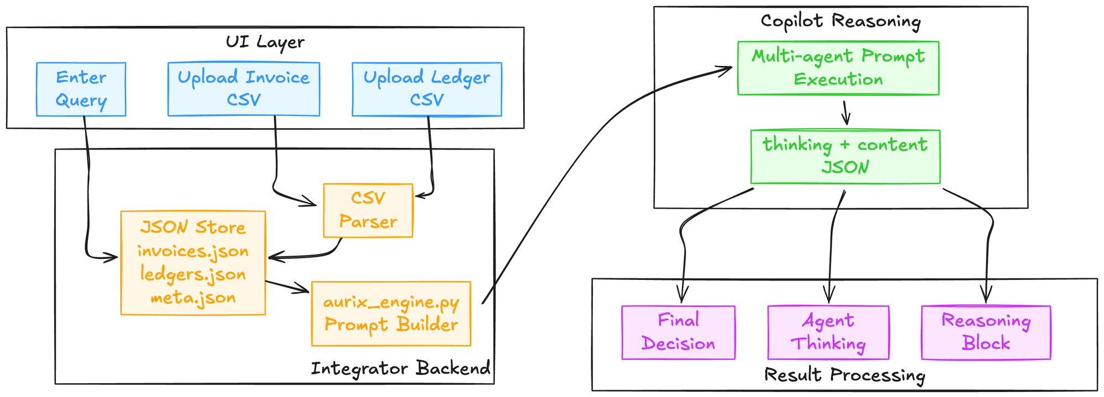
BANK OF AMERICA
HIGH-LEVEL ARCHITECTURE
Page 05

Slide 6


MULTI-AGENT WORKFLOW
BANK OF AMERICA
Query Rewriter
Retrieval & Similarity Agent
Normalizes the user query, extracts entities (invoice, ledger, vendor), and identifies intent.
03.
Selects top relevant invoices, ledgers, and policies using blended lexical + semantic similarity.
Core scoring:
where
01.
Query Planner
Converts interpreted intent into an ordered execution plan (retrieve → reconcile → policy_check → explain).
02.
Page 06

Slide 7


BANK OF AMERICA
MULTI-AGENT WORKFLOW
CONTD.
Reconciliation Agent
Compliance Agent
Explainer Agent
Matches each invoice to the best ledger based on vendor similarity and amount difference.
Amount deviation:
Evaluates matched pairs against policies and detects violations with severity scoring.
Policy triggers expressed as logical rules, e.g.:
Produces a structured, auditor-friendly Markdown summary covering reconciliation, policy checks, and final risk.
Synthesizes outputs into clear human-readable reasoning.
04.
05.
06.
Page 07

Slide 8
BANK OF AMERICA
PROMPT LAYERING STRATEGY
Key Message:
No embeddings
No retrieval vectors
Entire intelligence comes from agent instructions + JSON data + LLM reasoning
Each agent receives structured input & produces structured output
All combined into a single master prompt (final_prompt.txt)
Page 08

Slide 9
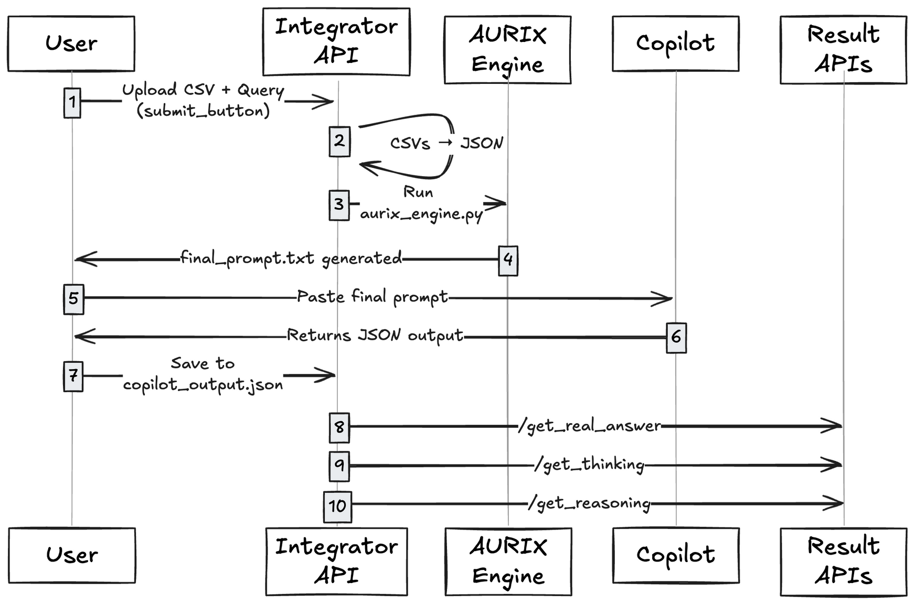
DEMO FLOW
BANK OF AMERICA
Contact
Home
Page 09

Slide 10
BANK OF AMERICA
STRENGTHS OF AURIX
Intelligent
Structured
Functional
Modular multi-agent architecture
Strong lexical + rule-based matching logic
Simple integration with downstream audit tools
Clear explainability (thinking trace)
Structured JSON output
Works with real enterprise audit structures
Page 10

Slide 11

BANK OF AMERICA
THANK YOU
FOR YOUR NICE ATTENTION
Because attention is all you need
Page 11

